Slide 1

        Erasmus plus project in Turkey (Uşak) 19th -24th November 2023

Slide 2
Steps to apply for a job

Slide 3
Before you start looking for work create your curriculum
1.Contact Information:
Include full name, phone, email, and LinkedIn.
2. Summary/Objective:
Craft a brief, tailored statement showcasing skills and goals.
3. Work Experience:
List jobs chronologically, emphasizing achievements with action verbs.
4. Education
Note degree, institution, and graduation with honors if applicable.
5.Skills:
Highlight technical and soft skills relevant to the job.

Slide 4
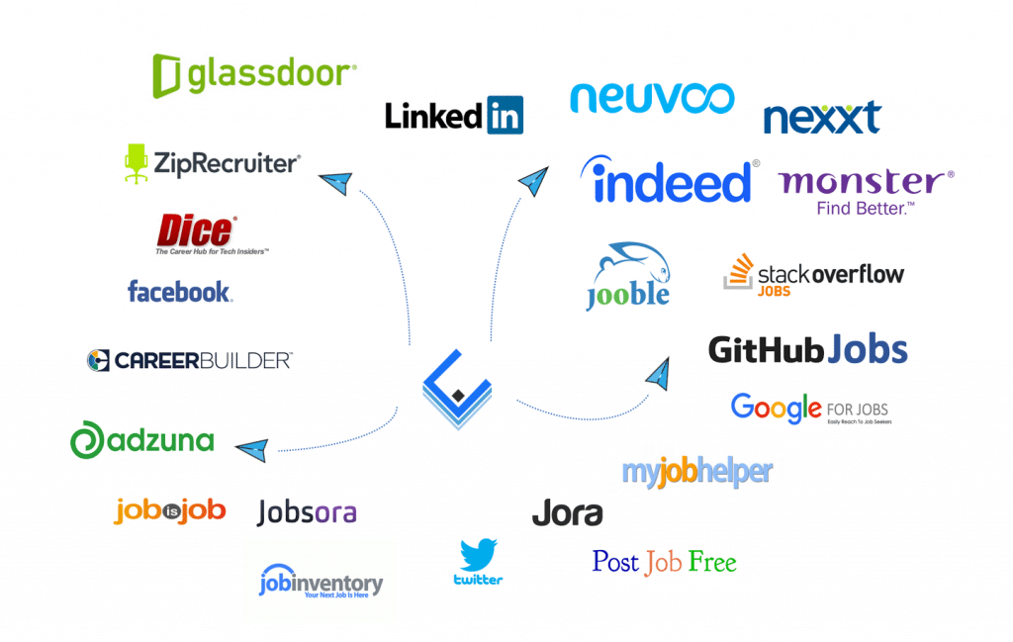
Websites of Job Listings:
Use specialized online platforms like LinkedIn, Indeed, Monster, or Glassdoor to search for job ads based on your skills and interests.

Slide 5

Agencies of Employment:
Look for employment agencies or recruitment agencies that can help you find job opportunities based on your skills and preferences.

Slide 6
The most famous agencies are:
Randstad
Randstad, Dutch recruitment pioneer, blends tech and human touch, excelling in diverse sectors, filling 670,000 positions annually.
Michael Page
Global consultancy Michael Page, part of PageGroup, excels in legal, tech, sales, marketing recruitment. Trusted, successful, consultative
Robert Half
Robert Half excels in finance, tech, and admin staffing, offering consultative services, industry research, and high satisfaction.
CPL
CPL excels in tech, science, and engineering recruitment, tailoring solutions, and achieving 94% client satisfaction.

Slide 7

Network of Professional Contacts:
Leverage your network of professional and personal contacts. Talk to friends, family, former colleagues and use networking platforms like LinkedIn to look for opportunities and get advice.

Slide 8

Networking Events and Job Fairs:
Attend networking events, job fairs and industry conferences. These events offer the opportunity to meet with company representatives directly, get information and deliver your resume.

Slide 9
        Thank you for your time
By
Michele Manuguerra
Alessandro Fontana
Claudio Leone

