Slide 1

Order Picker

Slide 2

What kind of profile does it require?
pick goods
locating objects on shelves
packing them
transporting them to trucks or shipping containers

Slide 3

How much does it pay?
Depends of the company
Average is 1803 to 2000 euro a month in Belgium
You work 40 hours a week

Slide 4

advantage and disadvantages
Advantages
Disadvantages
No specific study requirements
It pays well
Be concentrated
Work neatly

Slide 5

What are some of the career possibilities?
Supervisory position
Chief order picker

Slide 6

Which companies offer these jobs?
Almost all logistics companies, for example:
  Nike
  Kuehne & Nagel

Slide 7
How many vacancies are there?
Many vacancies
Go on the internet and type “logistic order picker”

Slide 8
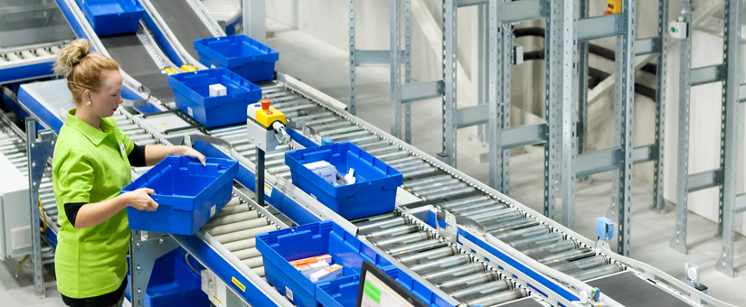
Port of Antwerp
The largest port of Belgium
many logistics workers wanted

Slide 9

Accountants

Slide 10

What kind of profile does it require?
helps businesses make critical financial decisions
tracking
correcting the company's finances
responsible for financial audits
reconciling bank statements
ensuring financial records are accurate throughout the year

Slide 11

How much does it pay?
0-2 experience = 3371- 4183
3-5= 3623- 4896
5-10= 4558- 7189

Slide 12
What are some of the advantages and disadvantages?
advantages
disadvantages
It pays well
A lot of laws and regulations
Long working days

Slide 13

What are some of the career possibilities?
Public Accountant
Tax Accountant
Forensic Accountant
Financial Accountant
Managerial Accountant
Financial Planner
Internal Auditor
Government Accountant

Slide 14

Which companies offer these jobs?
All accounting companies
other companies

Slide 15

How many vacancies are there?
A lot of vacancies = most companies need accountants
Go to interims

Slide 16

Compare the situation in the Campine with the situation in the port of Antwerp.
The largest port of Belgium
many logistics workers wanted

Slide 17
Video’s
https://www.youtube.com/watch?v=M32JRrVoVhQ
https://www.youtube.com/watch?v=WR2oftI_urg

Slide 18

Thank you for listening

