Slide 1
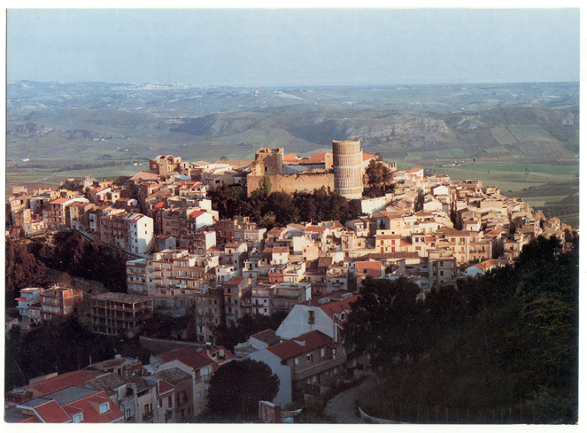
Our city…
SALEMI

Slide 2
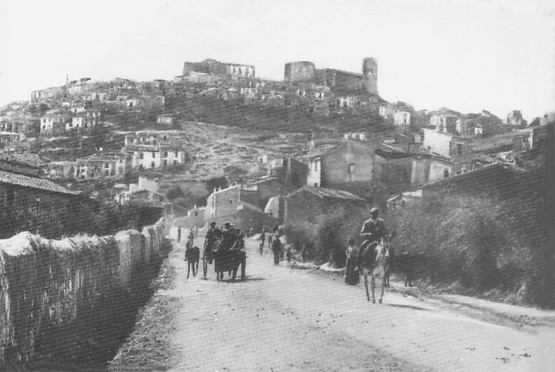
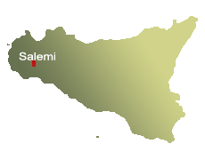
Salemi is a little town on a hill…
…in the north-west
of Sicily!

Slide 3
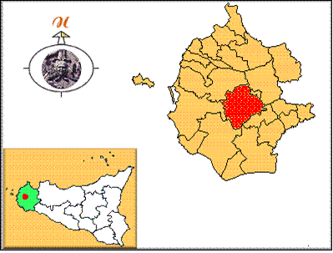
Salemi is in the provincial district of Trapani…
Salemi

Slide 4
In the past Salemi was occupied by Elimians, Romans, Arabs, Normans, Spaniards…

Slide 5
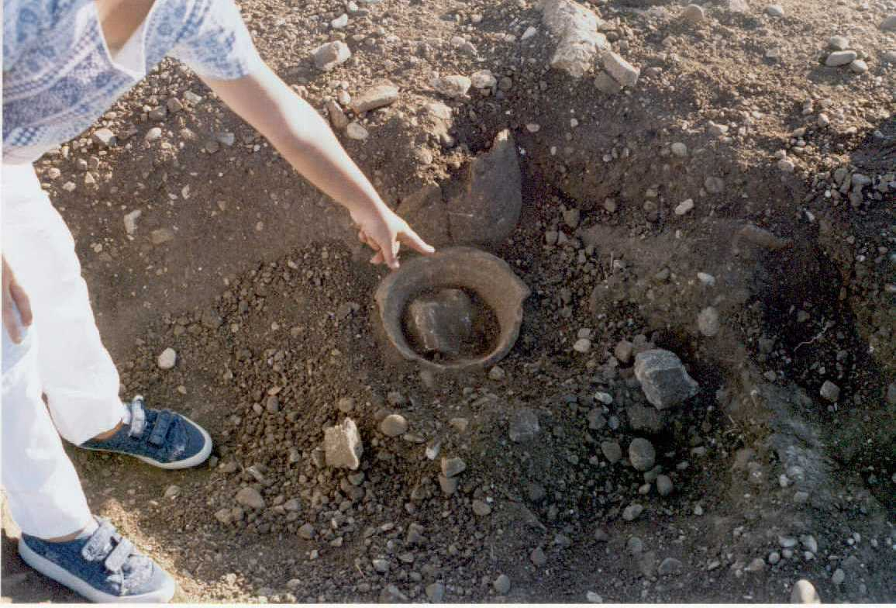
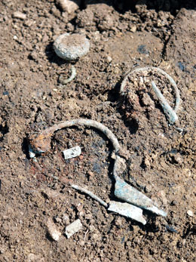
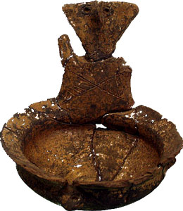
Today Salemi is rich of many archeological sites.

Slide 6
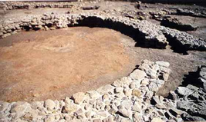
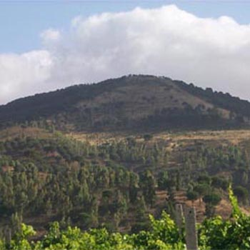
The Archeological sites are:
Mokarta
Monte Polizzo

Slide 7
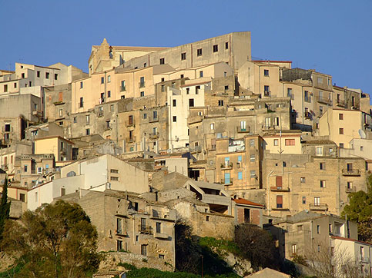
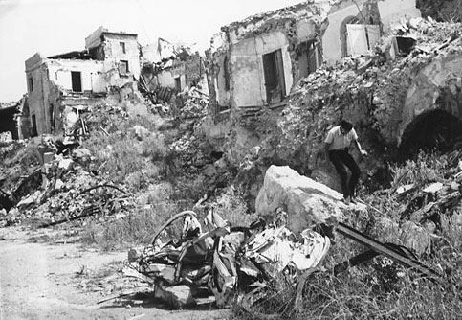
In 1968 Salemi was destroyed by an earthquake…
… the
ruins of these
terrible days are still visible.

Slide 8
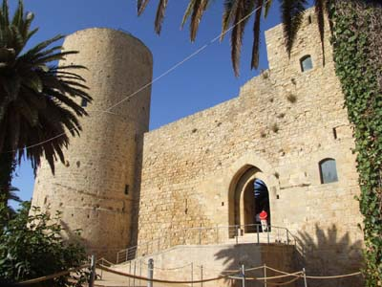
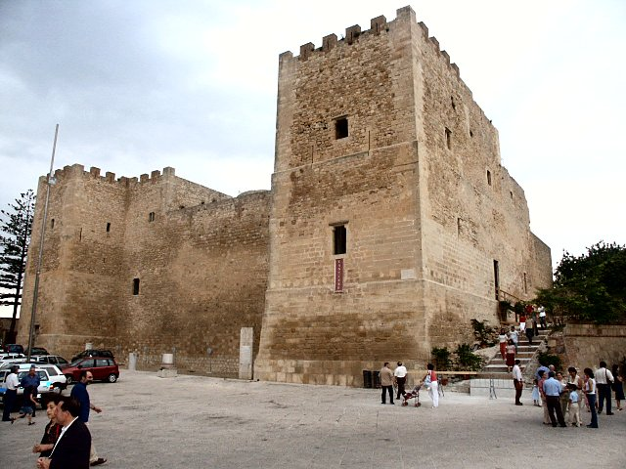
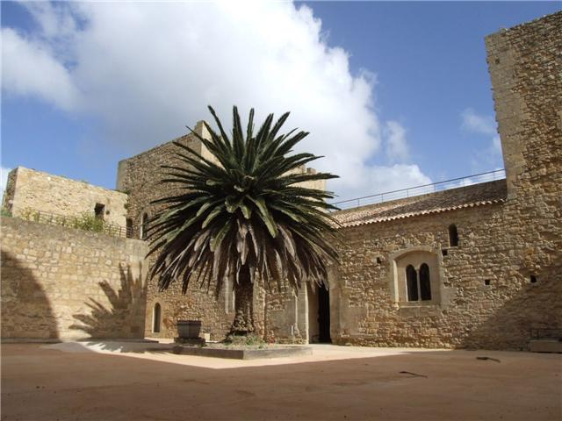
On the highest part of Salemi there is a Swebian-Norman castle

Slide 9
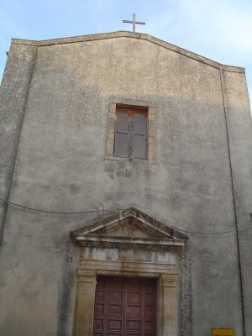
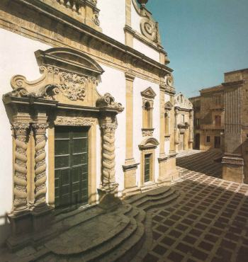
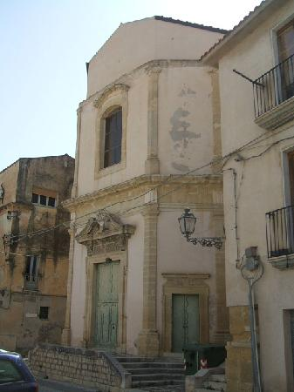
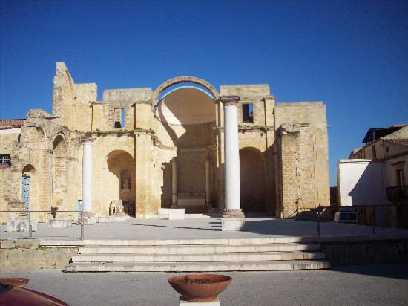
There are also
many churches…
Before the earthquake of 1968
there were about 50!

Slide 10
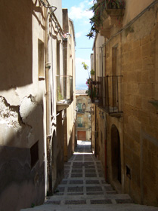
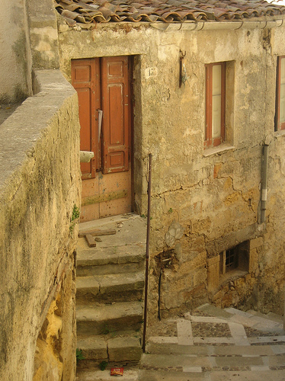
and
ancient corners…

Slide 11
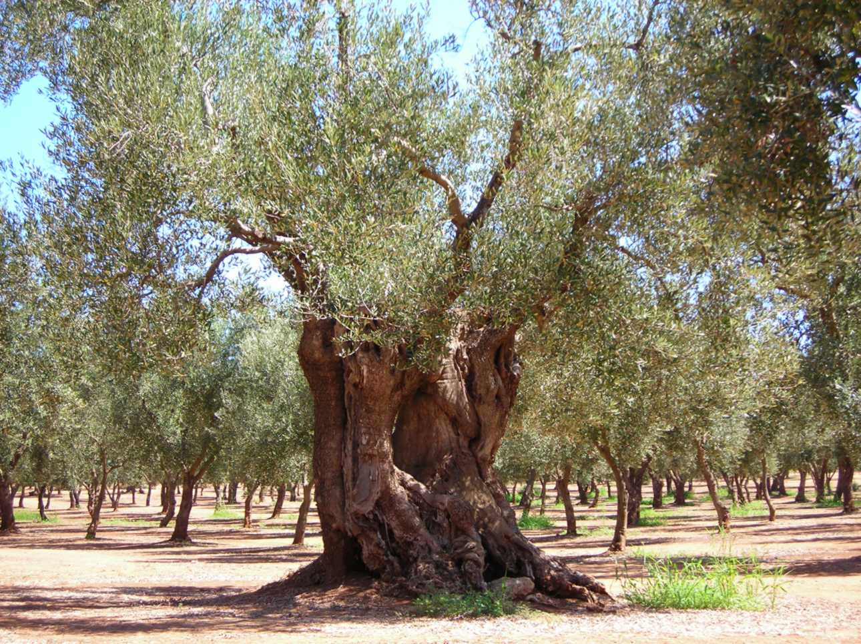
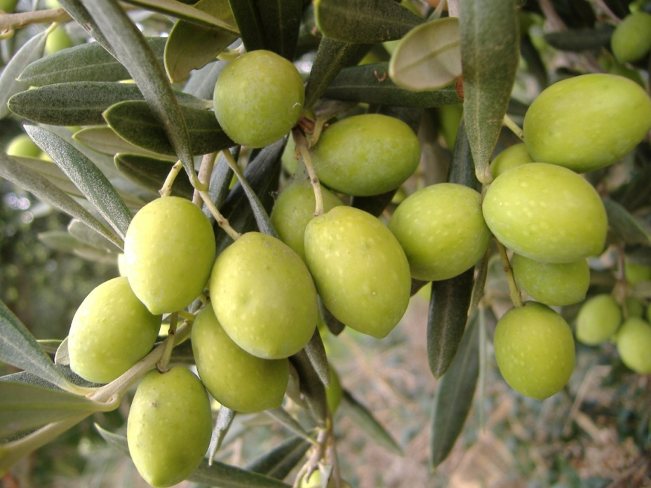
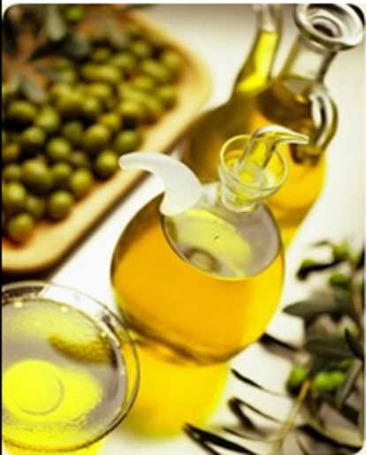
An important resource
of our land is the production of “extravergine” oil…

Slide 12
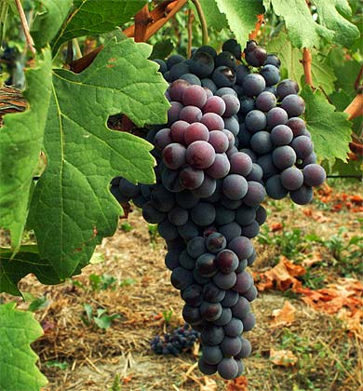
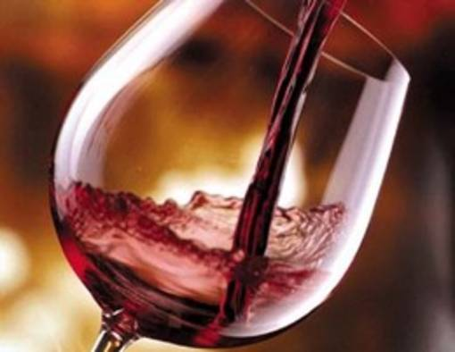
WINE!..another famous product of
Salemi…
You can find many vineyards around Salemi!

Slide 13
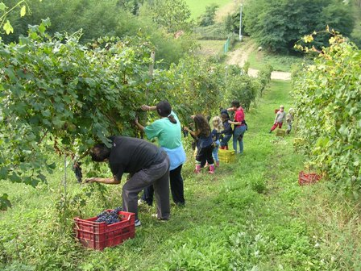
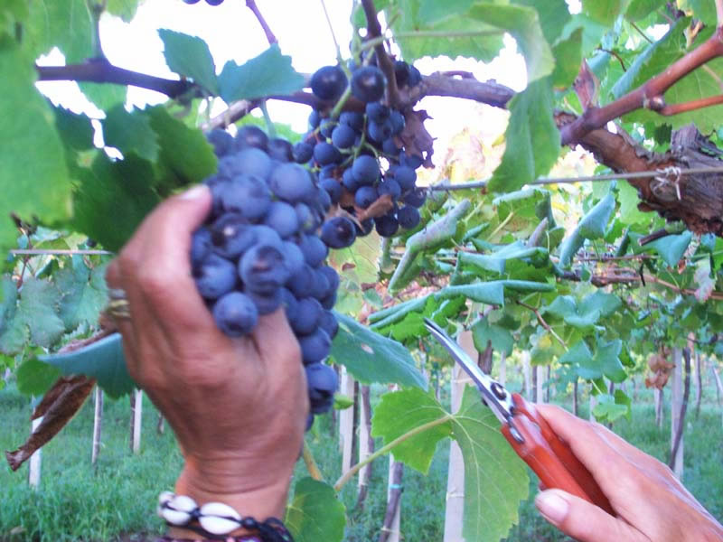
In September
a lot of inhabitants
harvest grapes!

Slide 14
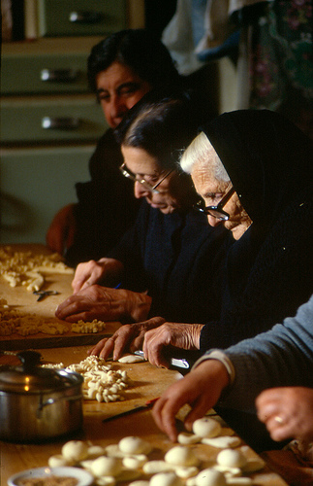
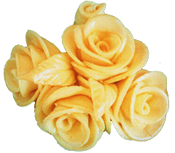
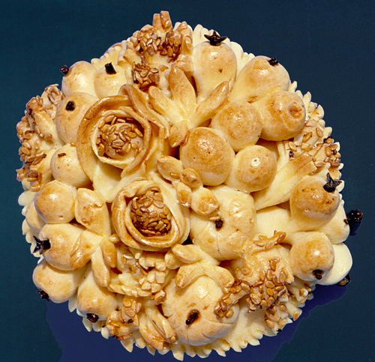
March 19th is
“St Joseph’s Day”…
Many people make
particular and beautiful shapes of bread artistically worked

Slide 15
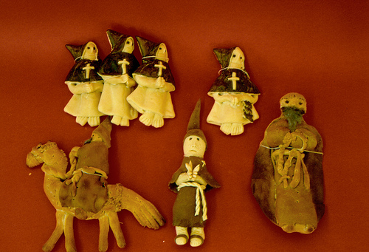
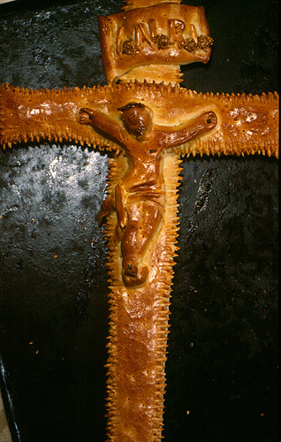
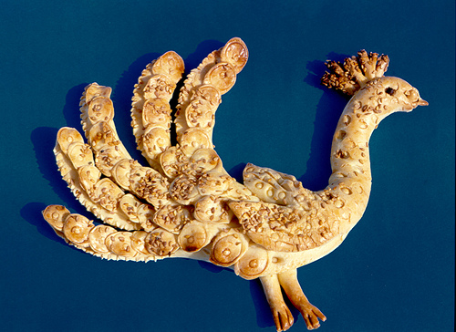
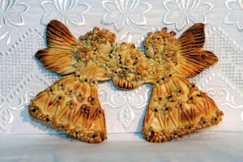
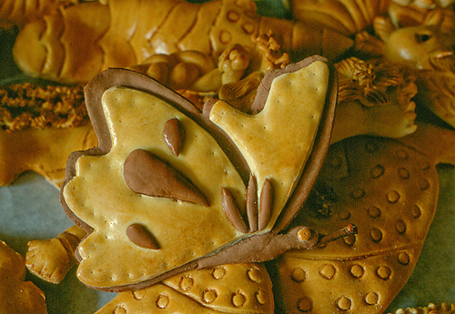
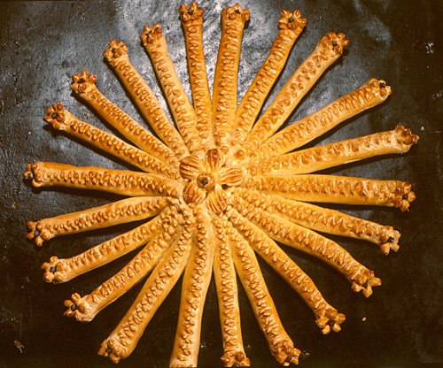
The bread can have some different shapes
Every single piece of bread represents a symbol
of Christian Religion
or local traditions

Slide 16
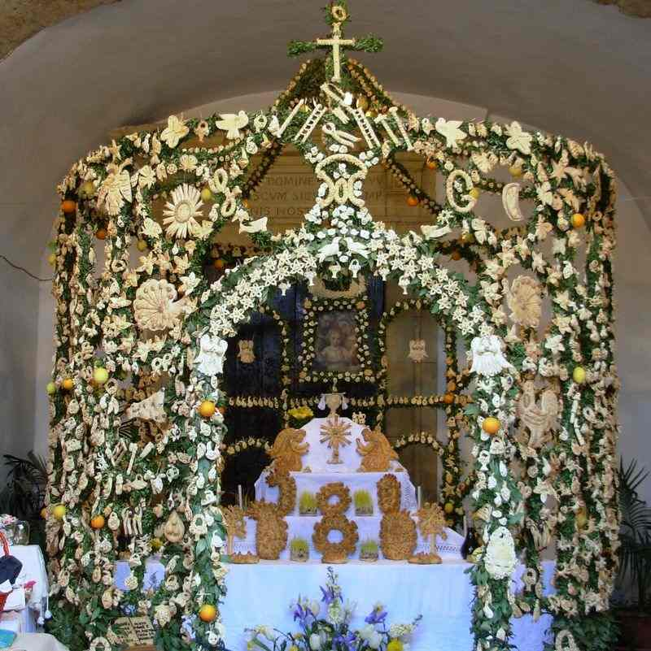
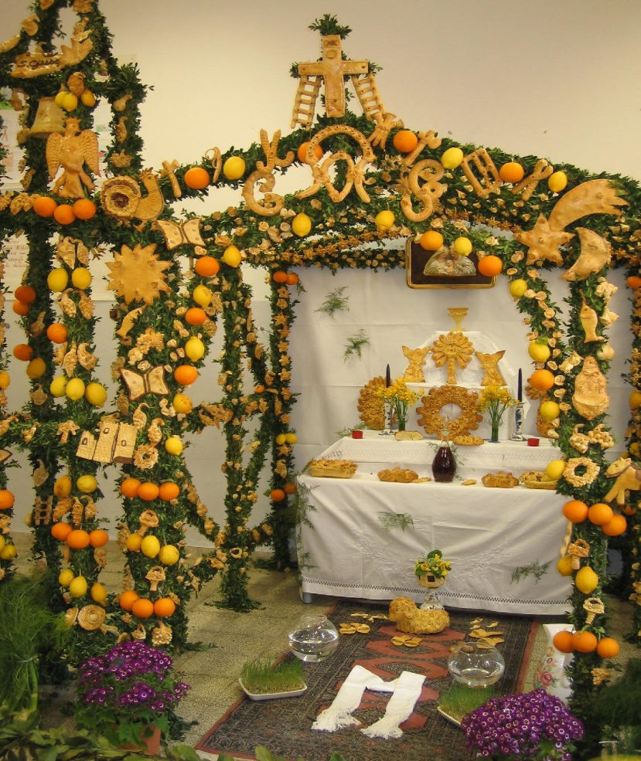
…and with these artworks
made of bread
they decorate the altars…

Slide 17
Other places in Salemi worth visiting are…

Slide 18
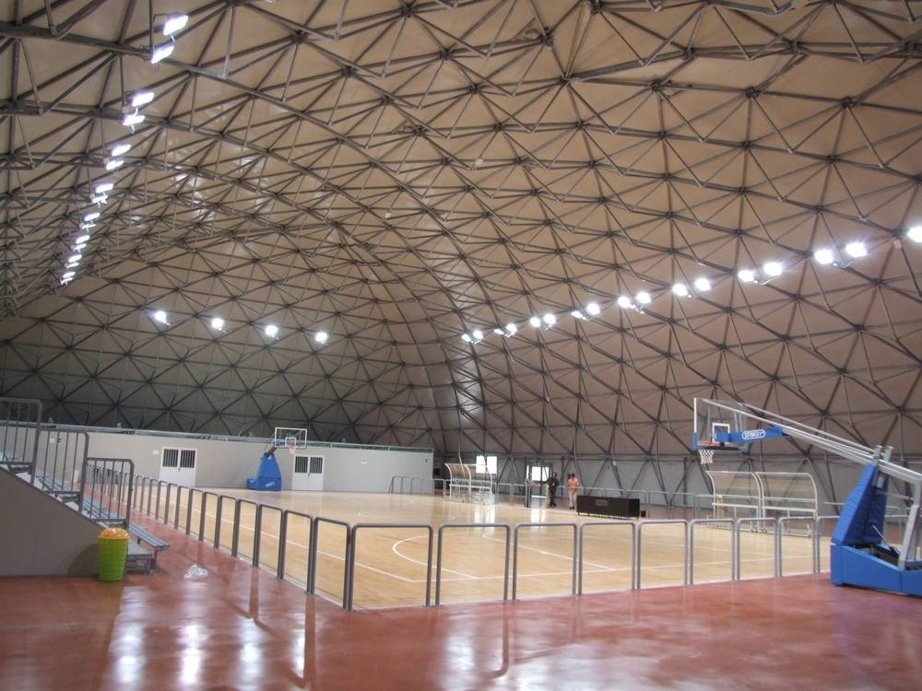
Our indoor stadium!
In this building, Salemi’s youngsters practise a lot of sports like basketball, volleyball, gymnastics…

Slide 19
In Salemi there are many elementary schools,
one big middle school and only two high schools… OURS!
Liceo Classico and Istituto Tecnico

